Slide 1
Embedded Firmware Essentials Final Project: JTAG debugging using Bus Blaster module
PROFESSOR: sheng-Liang song
Student: Vincent jison
UCSC Extension – fall 2016

Slide 2
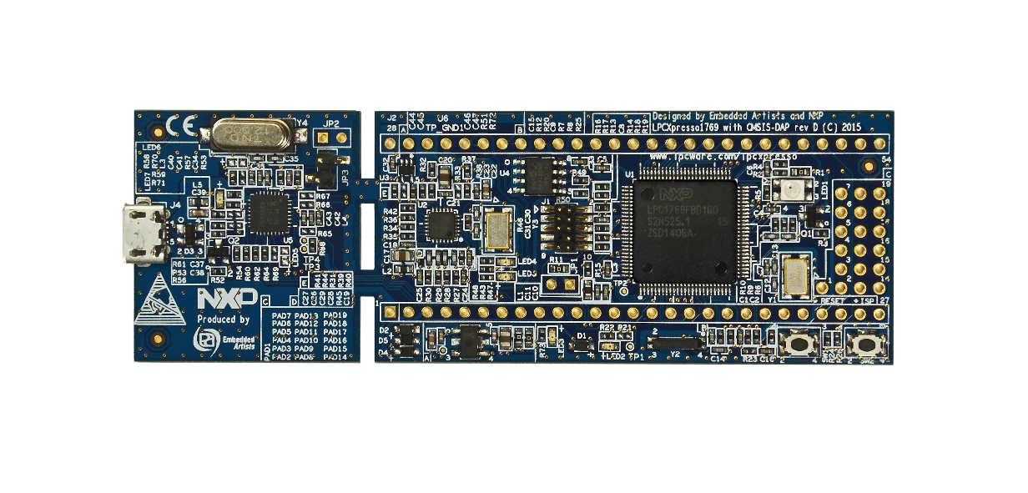
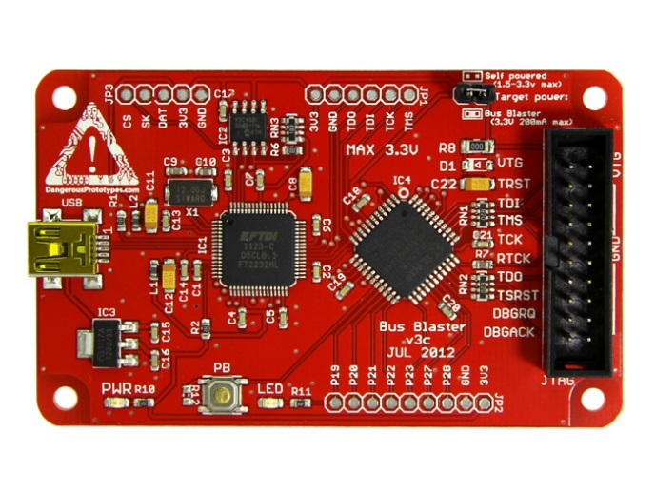
Introduction
I have never used JTAG before but in embedded systems design, learned in class that it is a very important tool used for debugging
I followed tutorial and obtained source code online:
http://alvarop.com/2013/02/debugging-arm-cortex-m3-devices-with-gdb-and-openocd
Board under test: NXP LPC1769 (rev. D) eval board
JTAG module purchased: Bus Blaster v3
https://www.seeedstudio.com/Bus-Blaster-v3-p-1415.html

Slide 3
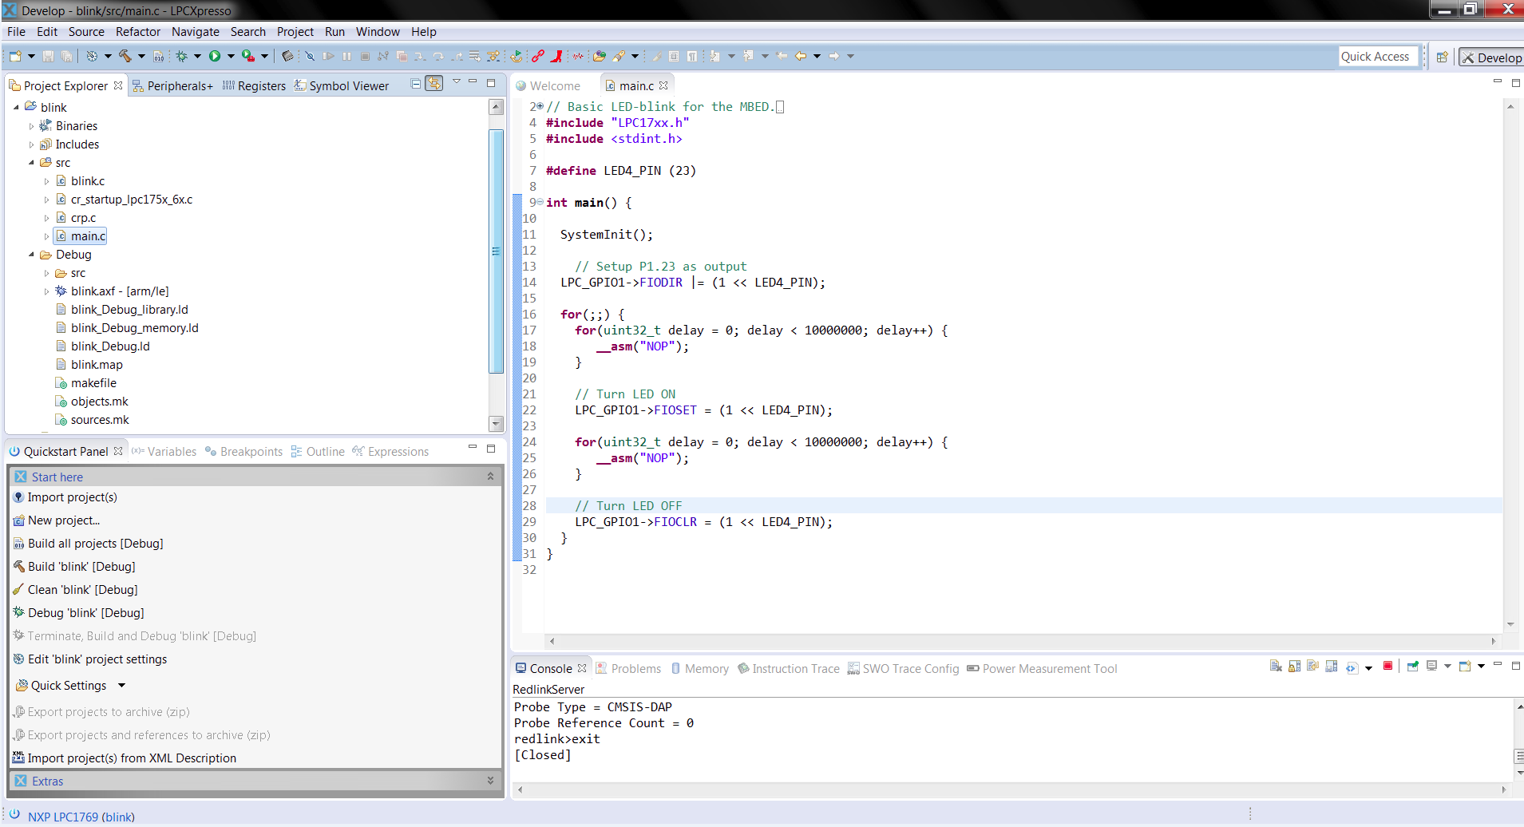
LPC1769 programmed using LPCXpresso IDE

Slide 4
OpenOCD 0.9.0
OpenOCD is open source software that allows you to interface to JTAG
http://openocd.org/about/
In linux: sudo apt-get install openocd
GDB (GNU Debugger) client
arm-none-eabi-gdb is used to debug ARM applications
Example: http://gnuarmeclipse.github.io/debug/install/

Slide 5
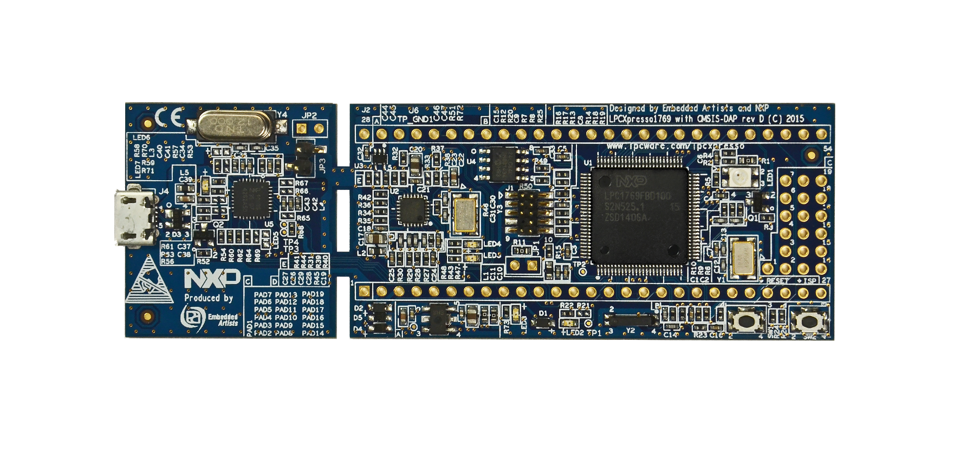
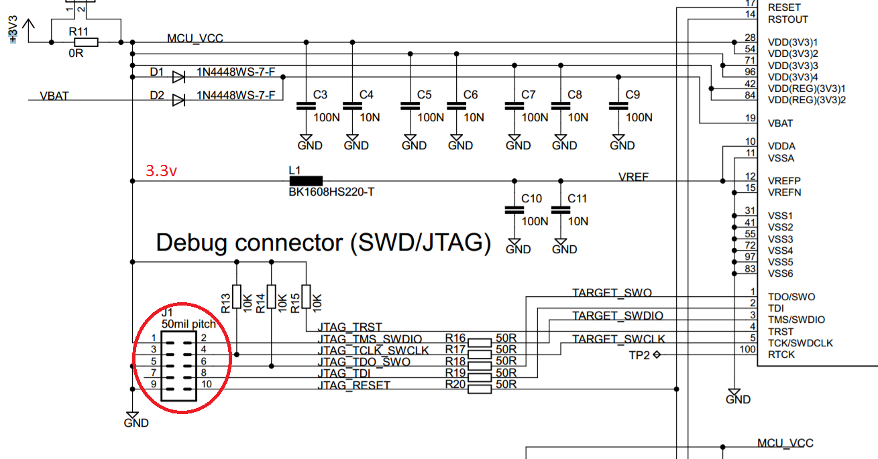
JTAG pin out on LPC1769 board

Slide 6
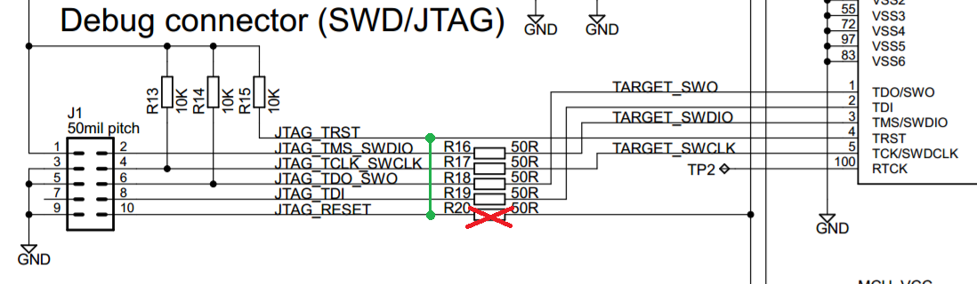
Rework the board
The JTAG_RESET jumper was incorrectly connected to the LPC1769 RESET (pin 17). It is supposed to be connected to TRST (pin 4).
Rework: remove R20, solder wire between JTAG_RESET and TRST

Slide 7
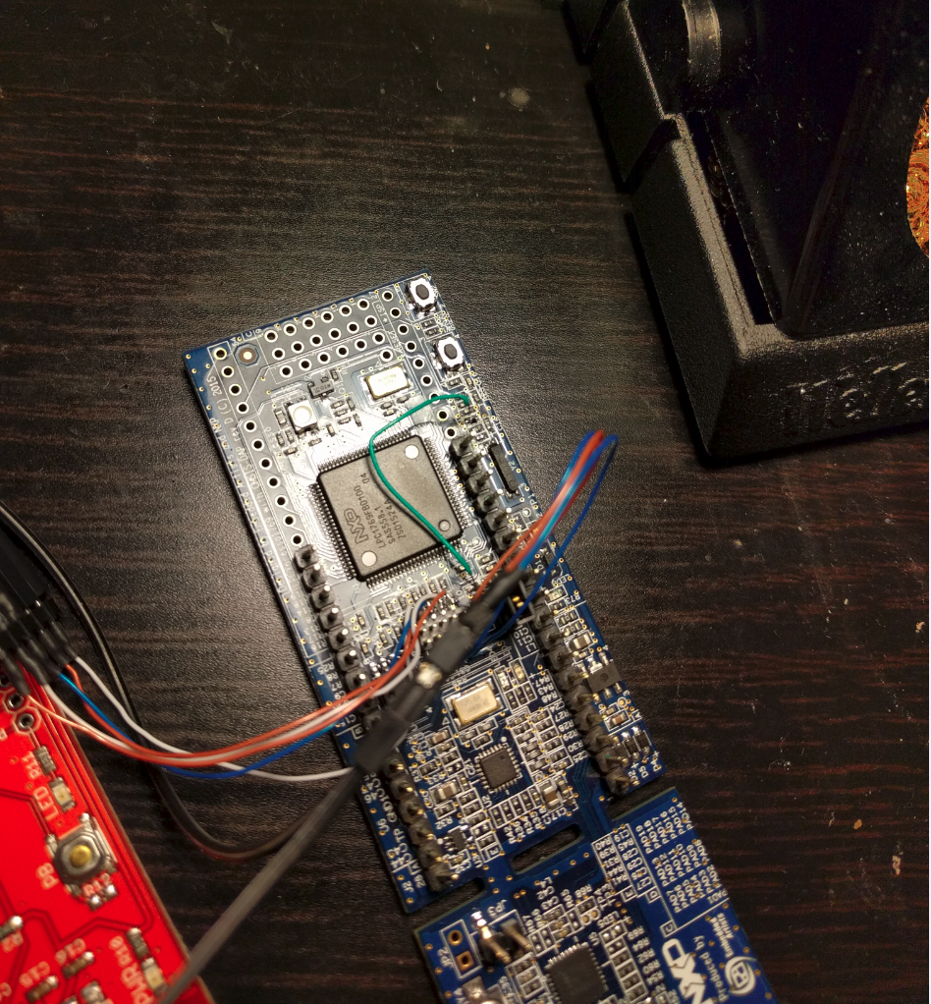
Solder wire between JTAG_RESET and TRST

Slide 8
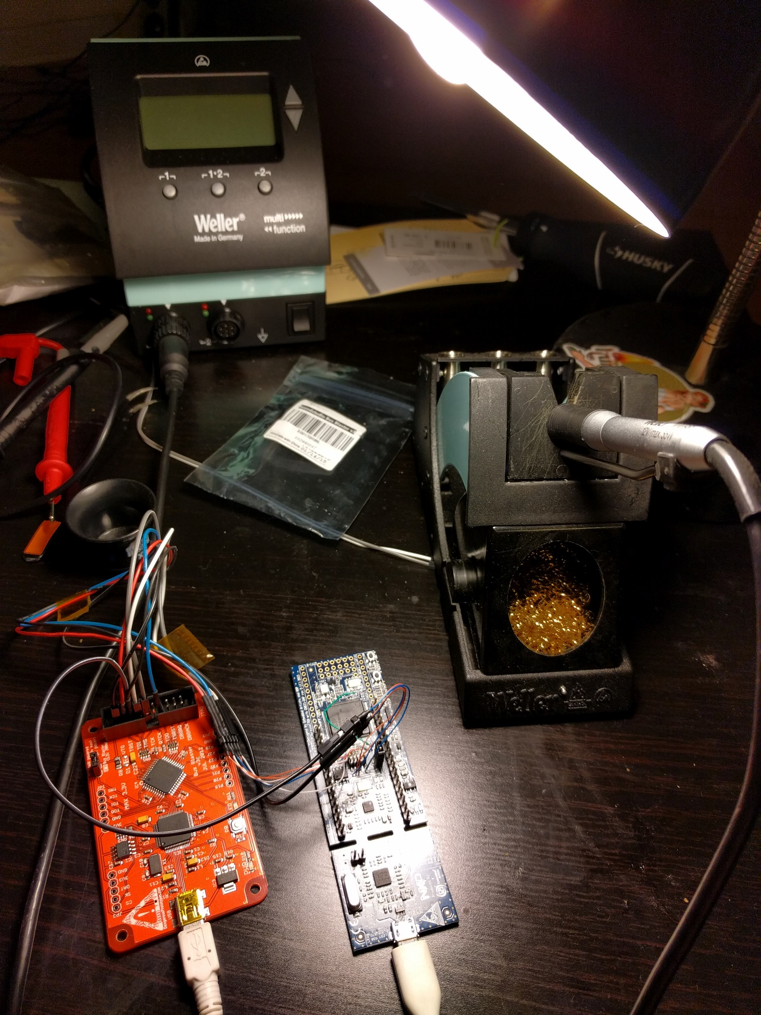
Connect Bus Blaster to LPC1769 JTAG pins
*please note, you must add jumper to JP3
on LPC1769 to allow for JTAG debugging

Slide 9
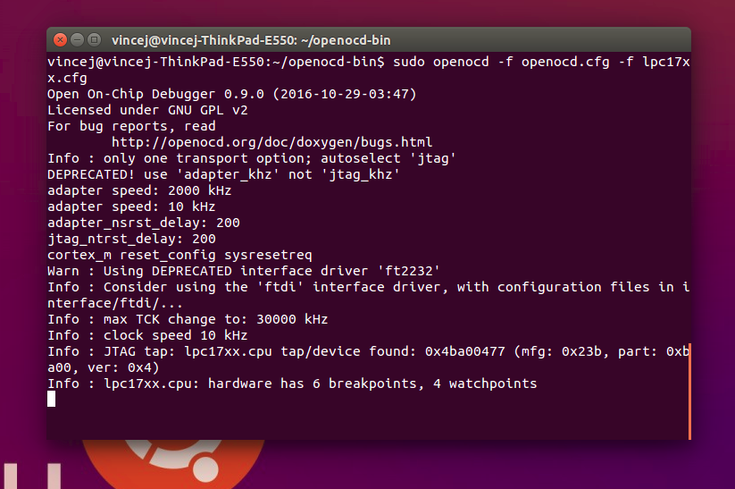
Access BusBlaster using OpenOCD

Slide 10

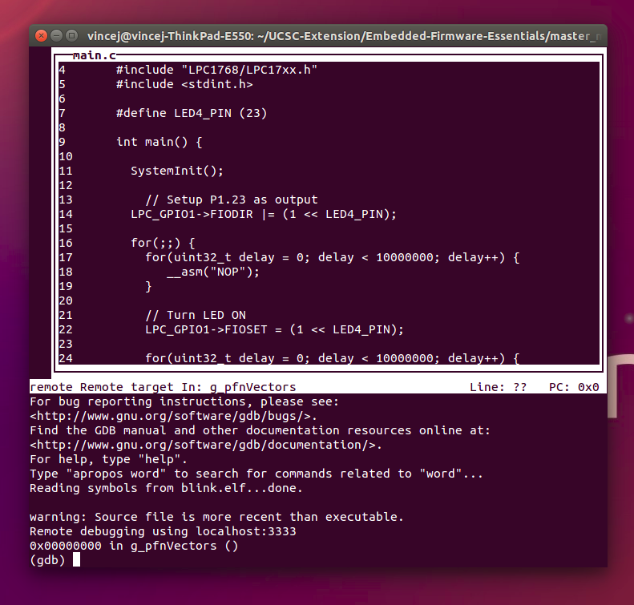
Start GNU Debugger Client
You now have access to your running code!
Use GDB commands to step through the code.
EXAMPLES:
(gdb) step = step into next line of code
(gdb) next = execute next line of code
(gdb) ctrl+c = halt execution
(gdb) continue = continue executing
More commands:
http://www.yolinux.com/TUTORIALS/GDB-Commands.html

